Slide 1
MA478 Project Proposal
CDT Joshua Blackmon and CDT Samin Kim

Slide 2
Problem Statement
Location
Population
Unemployment
Wealth
Weather
Young Male Count
Burglary Count

Slide 3
Research Question
What is the relationship between socioeconomic variables and the count of burglaries in Chicago?
Additionally, what other determinants significantly impact the frequency of burglaries in Chicago?

Slide 4
Sources of Variation
 | Explained Variation - Wealth of Area - Young Male Count - Population per Census Block - Weather (Temperature) - Temporal Factors (Month) | Unexplained Variation - Officer Presence - Age of Population - Education Level - City Funding - Race Makeup
Observational Units Census Block in Chicago
Response Variable Burglary Count

Slide 5
Hypothesis
Hypothesis 1: Areas with high unemployment rates and higher levels of wealth are related to a higher incidence of burglaries in Chicago.
Hypothesis 2: The hotter the weather is, the more burglaries are present.

Slide 6
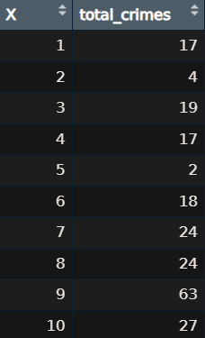
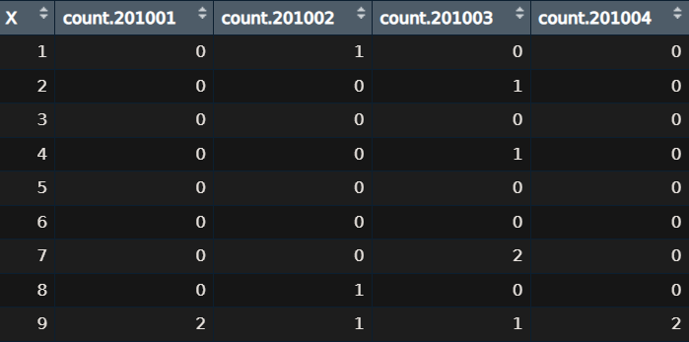
Data Description

Slide 7
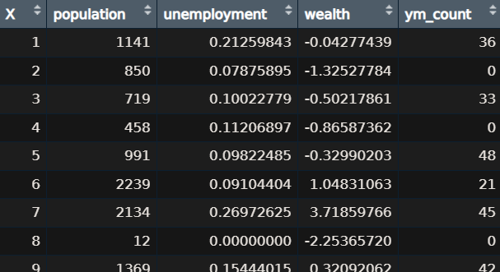
Data Description

Slide 8
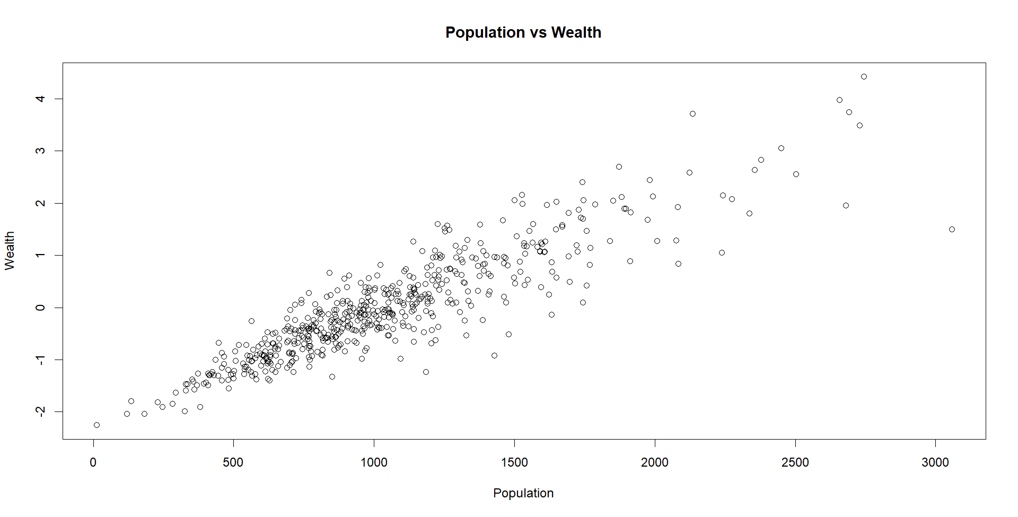
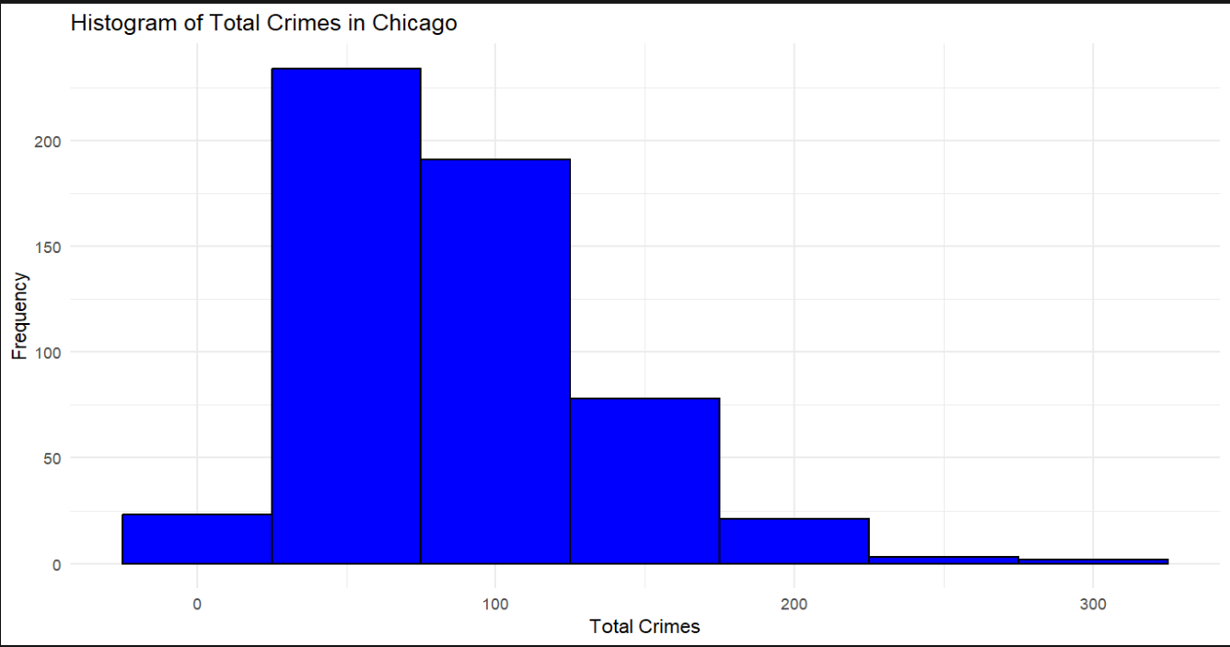
Initial Exploratory Analysis
After initial exploration, we found:
The range of burglaries in total between JAN 2010 and DEC 2015 is 2 and 291 burglaries.
Wealth and Population are highly correlated as seen below.

Slide 9
Proposed Model
Poisson
Negative Binomial
Poisson GLMM (Month, Census Block Location)
Suitable for count data (number of burglaries)
Assumes mean = variance
Suitable for count data (number of burglaries)
Accounts for overdispersion in data
Accounts for random effects from Month variable
$$\log\left(E\left(Burglaries\right)\right)=β_{0}+β_{1}\left(Unemployment\right)+β_{2}\left(Wealth\right)+B_{3}\left(Month\right)$$
$$\log\left(E\left(Burglaries\right)\right)=β_{0}+β_{1}\left(Unemployment\right)+β_{2}\left(Wealth\right)+u\left(Month\right)$$

Slide 10
질의응답??

